Slide 1
DevOps & Cloud Infrastructure SEIS 665 Week 11: Deployment Pipelines
Jason Baker
Adjunct Instructor
Graduate Programs in Software
University of St. Thomas
St. Paul, MN

Slide 2
Agenda
Deployment Pipelines
Jenkins
Jenkins Scripted Pipelines

Slide 3
Deployment Pipeline
A deployment pipeline is used to manage the deployment and testing of software using a set of validation stages whenever there is a code change.

Slide 4
Pipeline Benefits
Software is automatically built and tested (“ready-to-go”)
Making changes to software is much easier.
Every change is tested the same way
Easier to automatically deploy changes versus using manual methods
Reinforces practice of using small batch sizes
Compliance and governance tasks are easier.
Traceability improved and tests are enforced.
Reduces need for heavy change control tasks.

Slide 5
Basic Pipeline Design
Local development stage
Developers run and test software on their local workstation
Natively, virtual machine (vagrant), container
Linting: a static code analysis process which identifies common syntax and style defects using a linter application.
Unit testing

Slide 6
Basic Pipeline Design
Build stage
Usually triggered when a developer checks new code into a VCS
Linting process
Code compilation (when necessary)
Unit tests
Possible local execution tests
Package code and store in an artifact repository

Slide 7
Basic Pipeline Design
Testing stage
Code artifact is deployed to a testing environment
Automated API and/or GUI tests are run against environment
Both integration and end-to-end testing
May leverage a grid-based testing solution
Non-functional testing (service resiliency)
Performance testing
Manual testing (pipeline is stopped and manually retriggered)

Slide 8
Basic Pipeline Design
Production deployment stage/ release
Code artifact is deployed to production environment
May be first applied to a staging environment for further testing before production
Automated smoke tests are run against deployment to validate application working properly

Slide 9
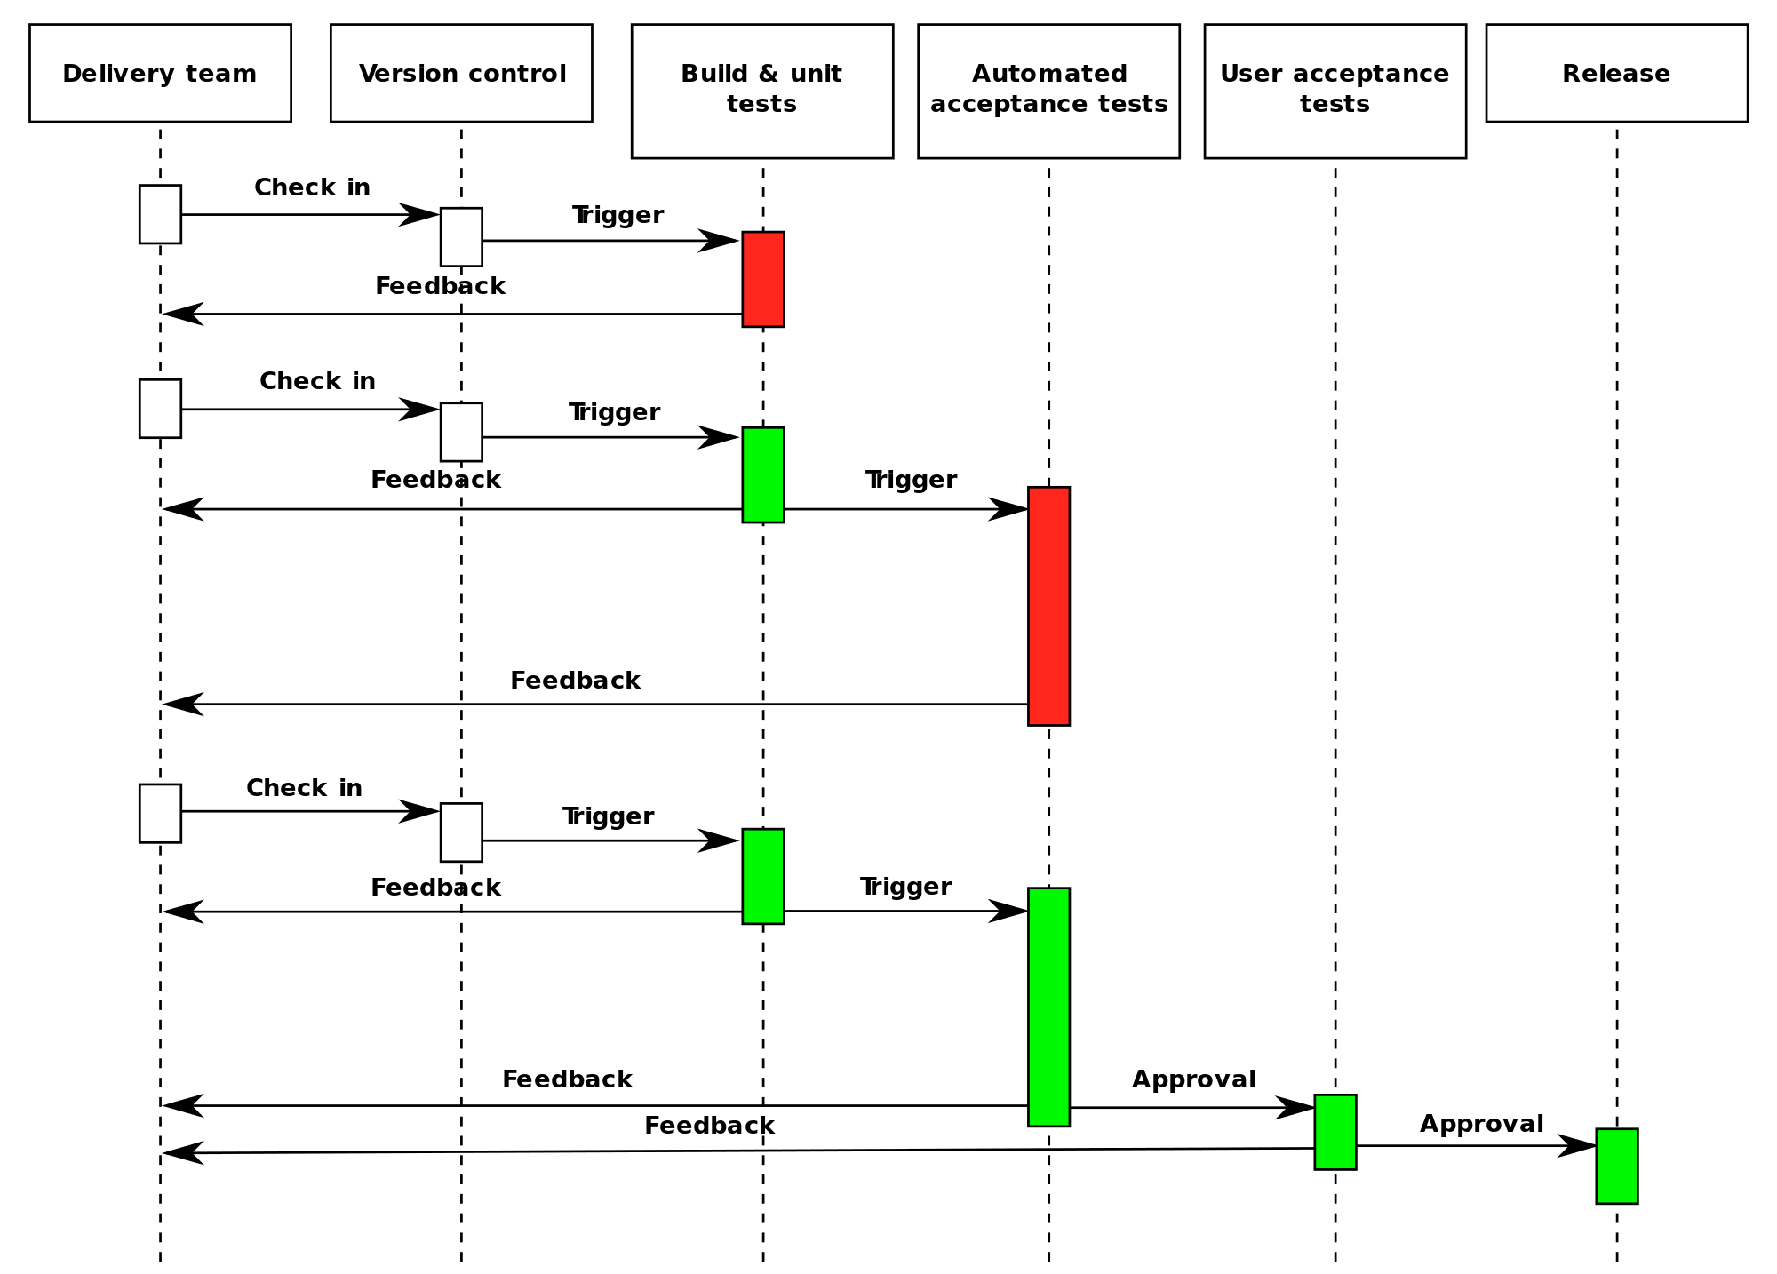

Slide 10
Deployment Pipeline Practices
Prove production-readiness for every change
All changes are potential releaseable
Only build your binaries once.
Don’t keep re-compiling or packaging app at each stage to minimize introduction of configuration inconsistencies.
Store application artifacts in a repository (example: Artifactory)
Deploy the same way to every environment.
Use the same script to deploy to a dev laptop, a test virtual machine, and a public cloud instance.
Store environment-specific configurations in separate files.
If any part of the pipeline fails, stop the line.
If a deployment to an environment fails, the whole team owns that failure and every effort should be taken to fix it.

Slide 11
Fan-in Pipelines

Slide 12
Shared library pattern
Oftentimes pipelines behave in similar ways
Same stages or method calls
We can create reusable pipeline code modules to share methods across multiple pipelines.

Slide 13
Jenkins
An open-source automation server written in Java.
Started at Sun Microsystems in 2004 and known as the Hudson project.
Forked in 2011 after Oracle bought Sun Microsystems and renamed Jenkins.
Commercial version available from CloudBees.

Slide 14
Launching Jenkins
TBD

Slide 15
Jenkins key terms
Jobs: define a specific set of tasks (workflow) which Jenkins will execute.
Workspace: a directory location on a Jenkins-managed system were a job will execute.
Executors: refers to the number of concurrent jobs that will run on a Jenkins system.
Environment variables: key/value pairs which a running job can use as input parameters.
Plugins: software modules which expand Jenkins functionality.

Slide 16
Jobs
Let’s create a freestyle job.

Slide 17
Homework
Assignment 9
Read Infrastructure as Code Chapters 9 & 10

